Slide 1
Feedback Lms
Mariam mohamed

Slide 2

Problem and goal (Why was this project developed?).
solving a common problem
share their complaints and suggestions
help students share their feedback and suggestions in a simple and effective way.

Slide 3
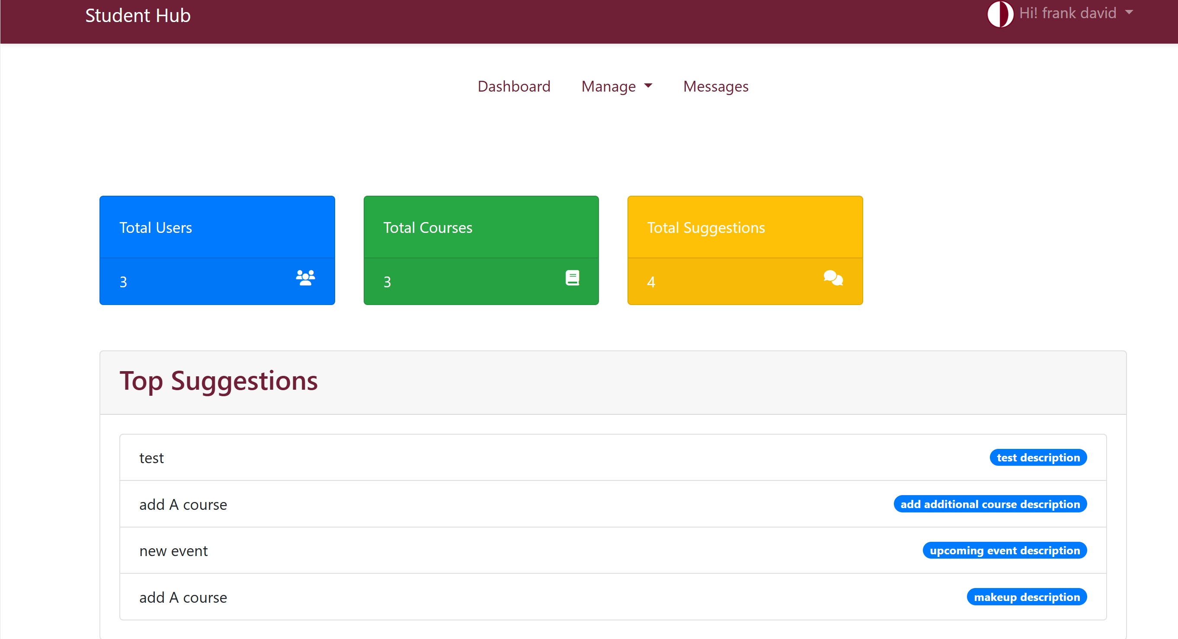
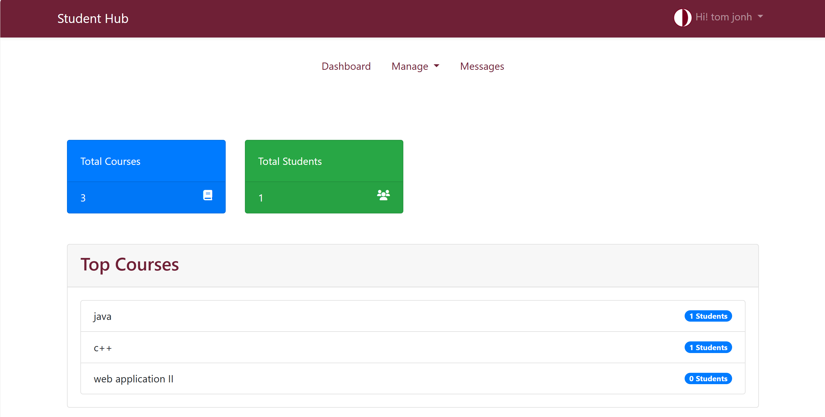
Frontend dashboards

Slide 4
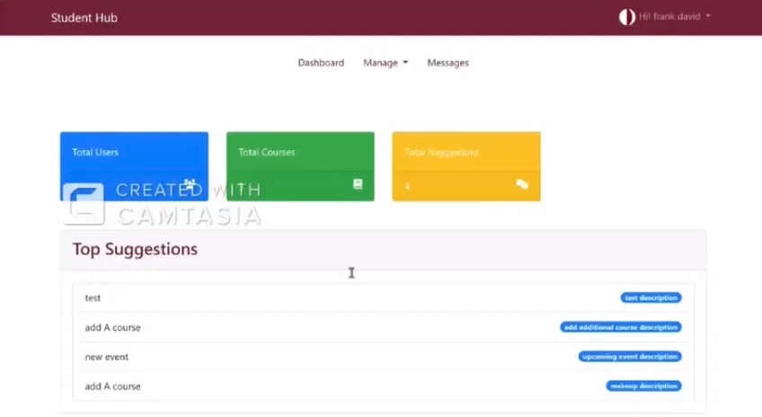
Admin dashboard

Slide 5
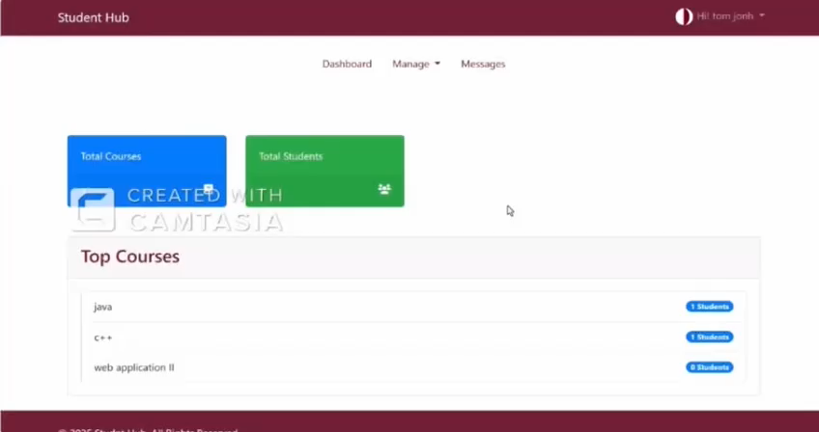
Instructor dashbard

Slide 6
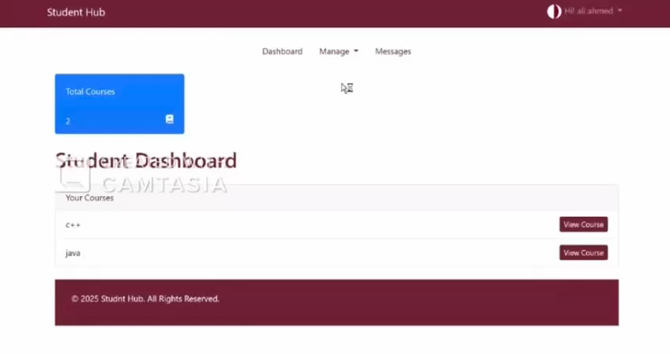
Student dashboard

Slide 7

Future improvements and conclusion
Adding ai → anlayze complaimts and suggestions automatically
Adding chatbot → provide smarter and more personalied responses

Slide 8
Thanks for listening!

